Slide 1
Practicum Phase II
Paul J. Hawron
Notes:
Welcome to my Phase II practicum presentation! To begin, I will be doing a quick recap of Phase I and then jumping right into the work I’ve been doing this semester.

Slide 2
Executive Summary
The Company, Business, and Industry
Problems and Concerns of Business
Notes:
For my Analytics Practicum project, I have been exploring data from the National Basketball Association (NBA). This organization is a collection of professional basketball teams that compete on a national level. The NBA is a business in the sports entertainment industry, with each team being a member of the association.
With the recent salary cap increases of the past few years, NBA players are turning into the highest-paid athletes of all time. Consequentially, teams are throwing large contracts at players who might not be deserving. To find a way to mitigate this issue, one of the solutions I have been working toward is to accurately value players based on their statistical contributions so that teams can allocate salary cap efficiently. In addition, we will be exploring what statistics are most essential to a team’s success.
My audience for this presentation is the analytics department for an NBA team.

Slide 3
Data Description
Data Source Identification
Data Source Description
Data Preparation
Notes:
The data I have been using is from the open-source website www.basketball-reference.com. This resource is the most complete collection of NBA data that exists to the public. It is updated regularly and accurately.
I have gathered the data from the years 2017-2019 and prepared it into two datasets:
1.) Player Stats – Player-level, year-level grain containing individual performance statistics. ~1,500 observations
2.) Team Stats – Team-level, year-level grain containing team performance statistics. 30 x 3 = 90 observations
Ultimately, this data will allow us to uncover hidden solutions to the focus of any sport: winning games. For the interest of teams and investors, however, this is two-fold in that winning games means making more money. By creating useful predictive models, we can more accurately spend our money in areas that will result in a larger return on investment.

Slide 4
Proposed Plan From Phase I
Question 1: What sets successful teams apart?
Playoff teams and teams that beat expected wins
Explore what advanced statistics have significant marginal value
Make recommendations to improve team rosters
Question 2: How can we accurately value player contracts?
Make salary recommendations based off player statistics
Notes:
I condensed my plan into two main questions:
Question 1: What sets successful teams apart? For this question, successful is being defined as playoff teams or teams that beat expected wins. I will explore the advanced statistics of these teams across time and use them in my models to make improvement recommendations.
Question 2: How can we accurately value player contracts? For this, we will see what statistics are most significant in player salaries. Using models with these variables, we can evaluate the market for which players are over- or under-paid.

Slide 5
Question 1
What sets successful teams apart?
Notes:
Now that we are caught up, let’s dive into our first business question: What sets successful teams apart?

Slide 6
What sets successful teams apart?
Definition of success:
Beat Expected Wins
Playoff Team
What statistics are the most important?
Find variables
Make predictions
Notes:
As stated earlier, we are looking at teams that made the playoffs or beat the expected number of wins that were set for them at the beginning of the season.
We will look at the best models for the problem and their effectiveness.

Slide 7
Beat Expected Wins
Notes:
First, teams that beat expected wins.

Slide 8
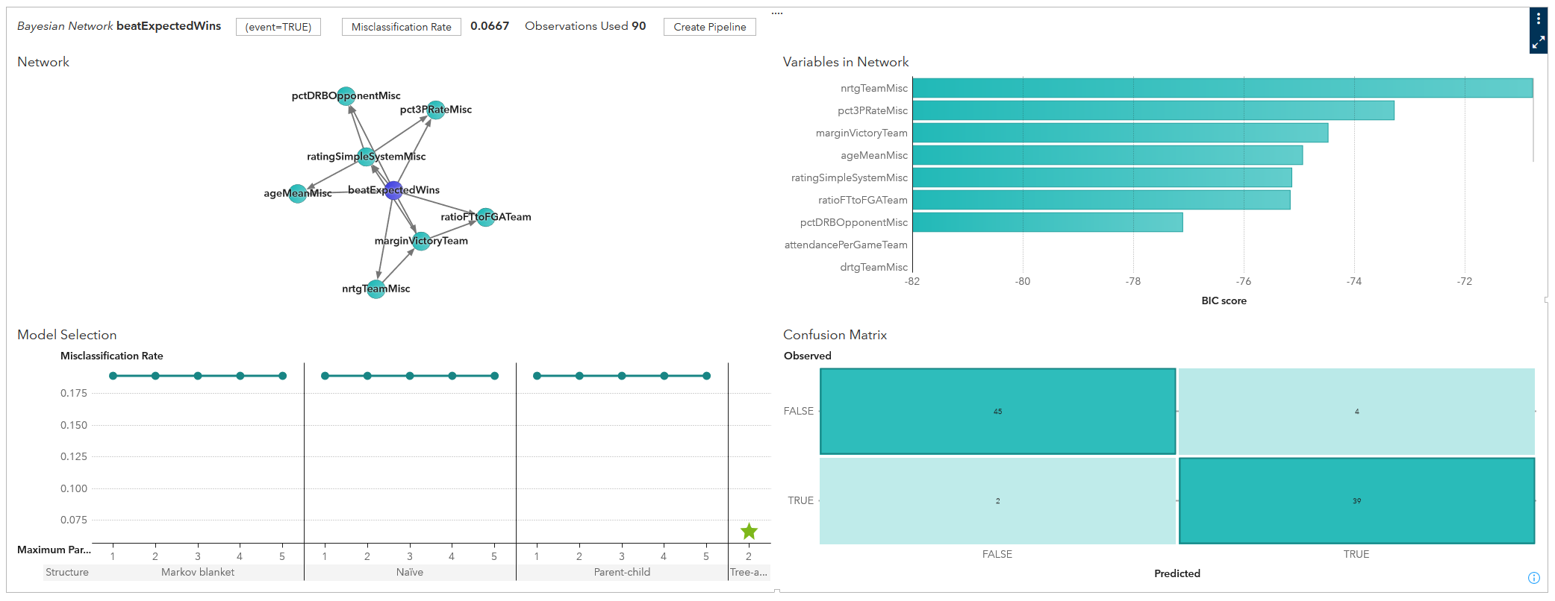
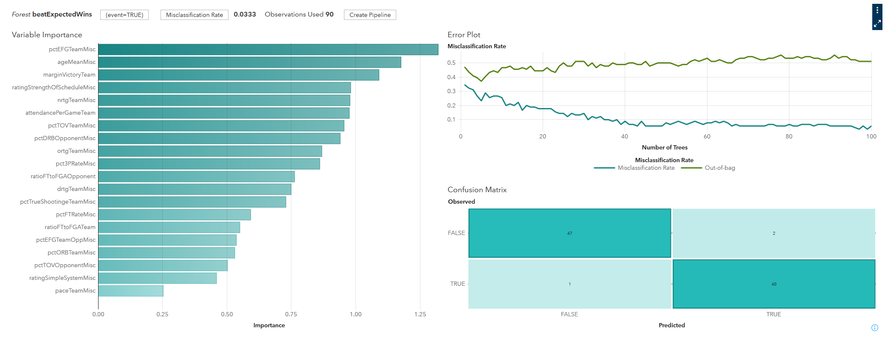
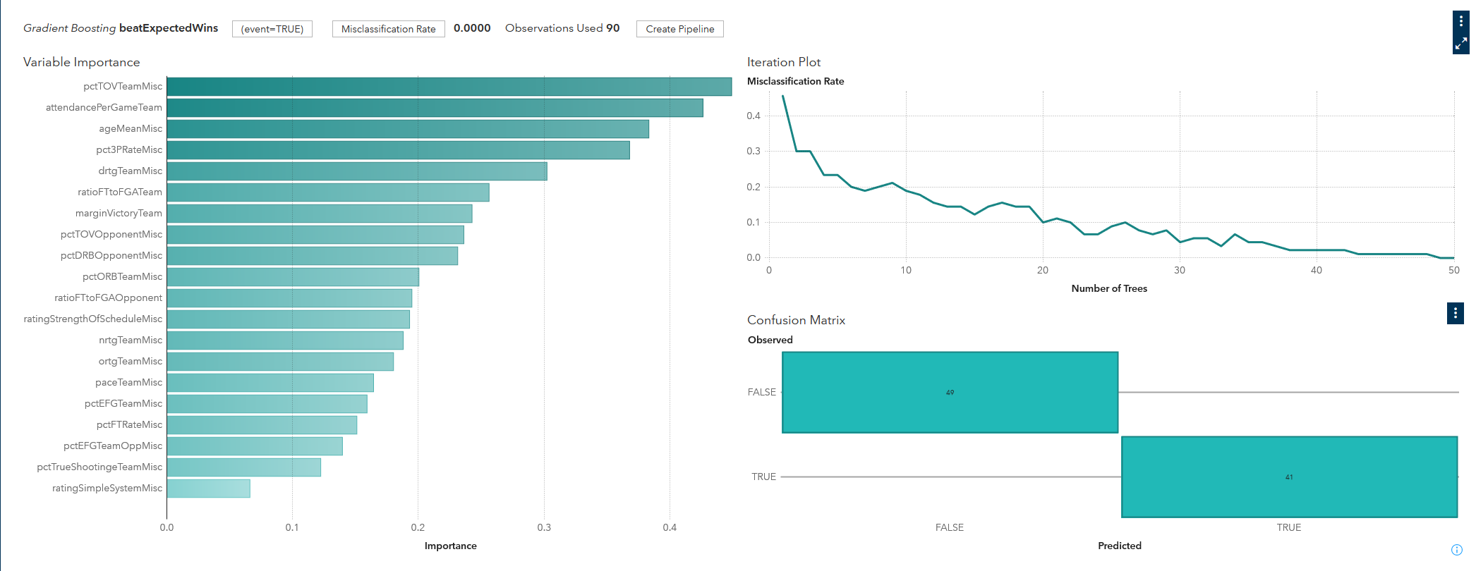
Best Models
Bayesian Network
Random Forest
Gradient Boosting
Notes:
To predict whether a team will beat predicted wins, I produced these three models as my best: Bayesian Network, Random Forest, and Gradient Boosting.
I finished with misclassification rates of 7%, 3%, and 0%, respectively.
With the actual predictions, I used an ensemble of these three models to combat overfitting and hedge against their biases and weaknesses. However, I wanted to run them all individually to look at their feature selections and use it to narrow my focus for the later analyses.

Slide 9
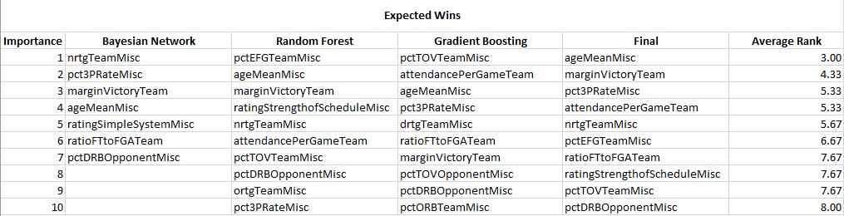
Averaged Ranks
Notes:
With some manual feature engineering, I averaged the ranks of each feature present in the three models and selected the overall top 10 as the final variables of importance for predicting whether a team will beat expected wins. We will dive deeper into this later.

Slide 10
Playoff Team
Notes:
Continuing that, we will look at how the same three models performed for predicting playoff teams.

Slide 11
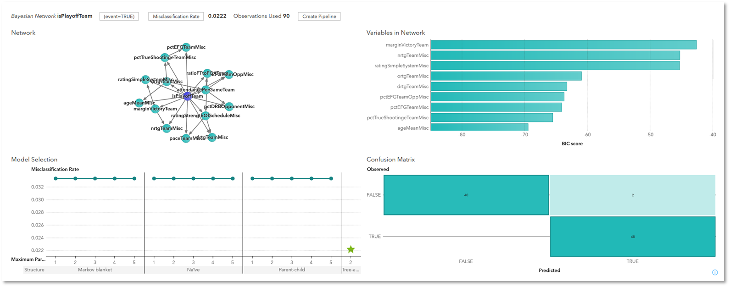
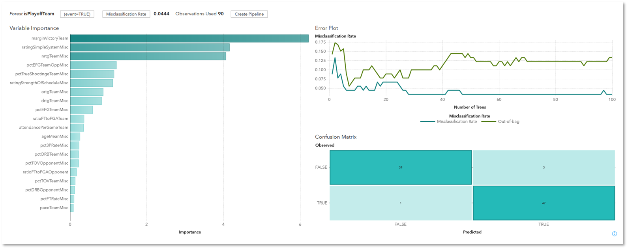
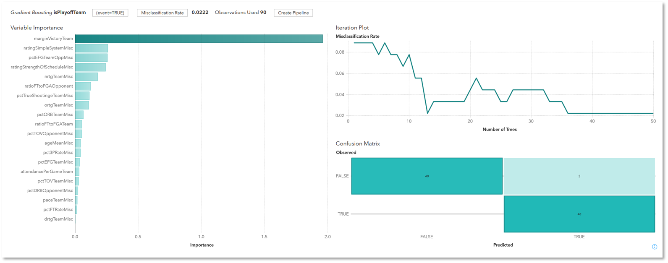
Best Models
Bayesian Network
Random Forest
Gradient Boosting
Notes:
The process for this target follows the pattern as the last. With this target, it is important to note that the split of teams if closer to 50/50, so overfitting might not be as prevalent. Still getting very low misclassification rates.
This random forest model is where things start to get slightly different with feature selection. Here, we can see that there are three features that are significantly more important than any others.
With the gradient boosting model, the previous skew of feature importance is exponential. This is important to note as we look at final variables of importance.

Slide 12
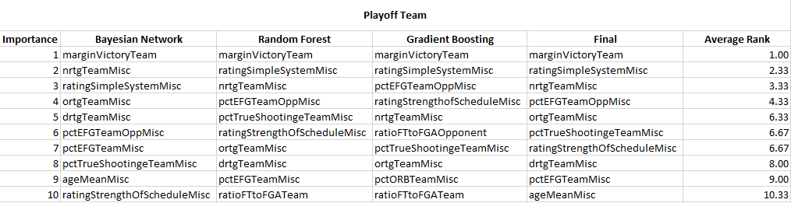
Averaged Ranks
Notes:
Some more manual feature engineering – we are presented with a much more clear-cut picture of the important variables for predicting whether a team will make the playoffs. Margin of victory was selected #1 in all three models.

Slide 13
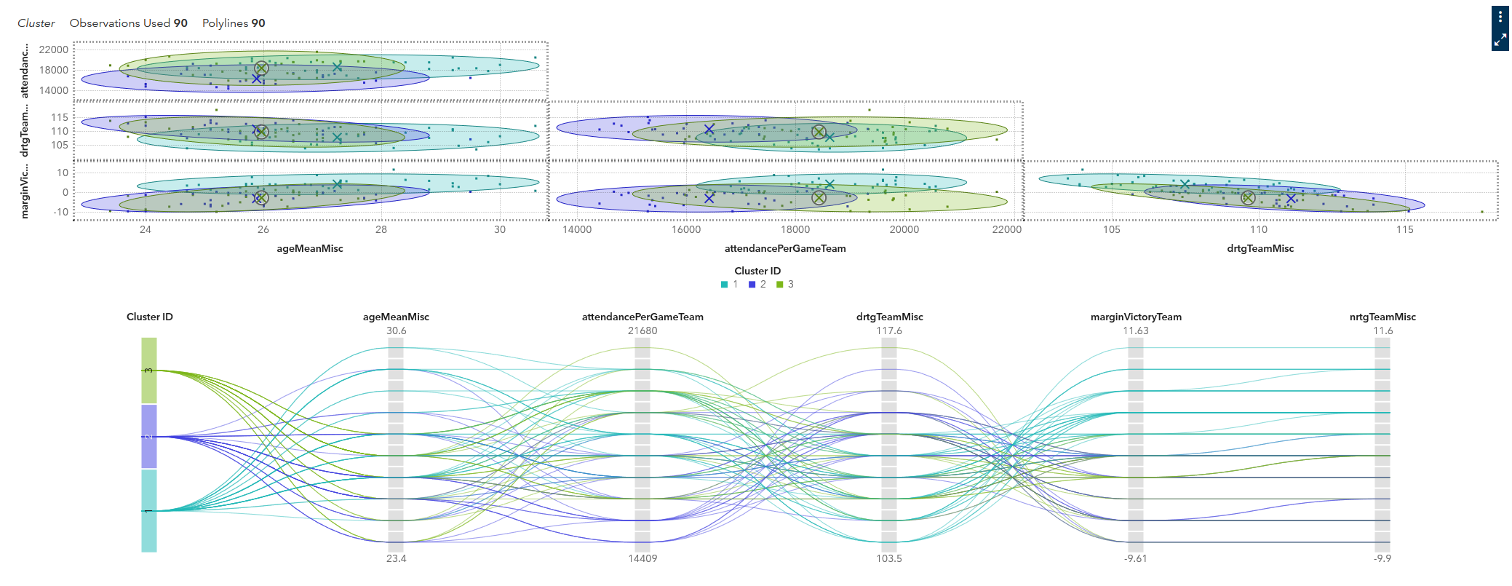
Team Clusters
Notes:
The next step was to use K-mean clustering to generate clusters of teams so that we can easily crosstab the statistics of different types of teams.

Slide 14
Team Clusters
Cluster ID | 1 - Playoff Teams | 2 - Beat Expected Wins | 3 - Everyone Else | League Average
attendancePerGameTeam | 18653.57 | 16374.96 | 18442.25 | 17904.2444
ageMeanMisc | 27.26 | 25.86 | 25.97 | 26.4389
drtgTeamMisc | 107.65 | 110.88 | 109.73 | 109.2633
marginVictoryTeam | 4.28 | -2.88 | -2.57 | 0.0006
nrtgTeamMisc | 4.35 | -2.87 | -2.62 | 0.0122
ortgTeamMisc | 111.99 | 108 | 107.1 | 109.2756
pct3PRateMisc | 0.35 | 0.32 | 0.33 | 0.3373
pctDRBOpponentMisc | 77.49 | 76.21 | 77.65 | 77.1589
pctEFGTeamMisc | 0.53 | 0.51 | 0.51 | 0.5198
pctEFGTeamOppMisc | 0.51 | 0.52 | 0.52 | 0.5197
pctTOVTeamMisc | 12.59 | 13.3 | 12.28 | 12.7067
pctTrueShootingeTeamMisc | 0.57 | 0.55 | 0.54 | 0.5561
ratingSimpleSystemMisc | 4.13 | -2.71 | -2.57 | -0.0024
ratingStrengthOfScheduleMisc | -0.15 | 0.18 | 0.01 | -0.0024
ratioFTtoFGATeam | 0.2 | 0.21 | 0.18 | 0.1985
Notes:
I ended up with three clusters that were fitted exactly as I hoped – Cluster 1 is teams that made the playoffs, Cluster 2 is teams that beat expected wins, and Cluster 3 is teams that did neither. Added in there is the league average for all teams.
We will take a closer look at these clusters and the variables of importance when we look at our specific predictions.

Slide 15
Question 2
How can we accurately value player contracts?
Notes:
Before we see the models in action, I want to go over the second business question: How can we accurately value player contracts?

Slide 16
How can we accurately value player contracts?
Targets:
Salary
All-Star Status
What statistics are the most important?
Find variables
Make predictions
Notes:
For this, we will be fitting models to predict player salaries, as well as to predict all-star status. This process will follow the same method as the models for team performance, but at the player level.

Slide 17
Salaries
Notes:
First, let us look at player salaries.

Slide 18
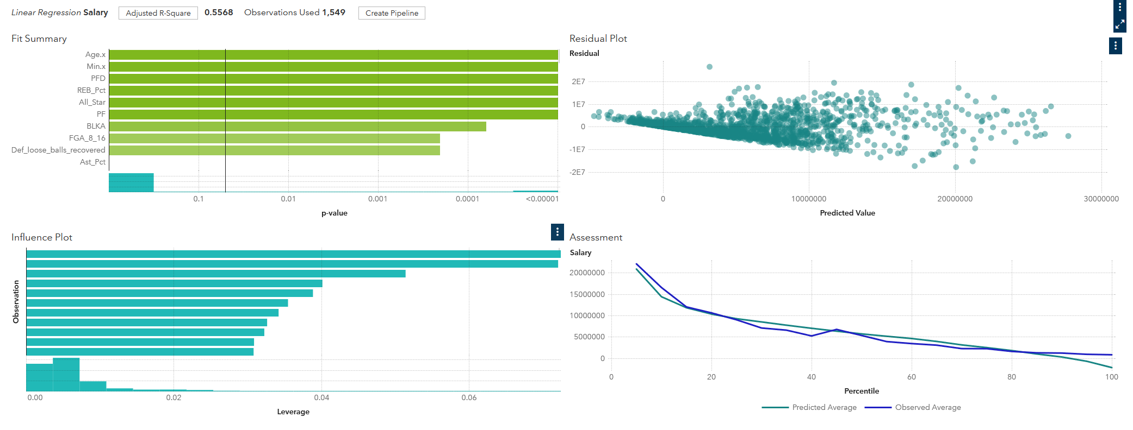
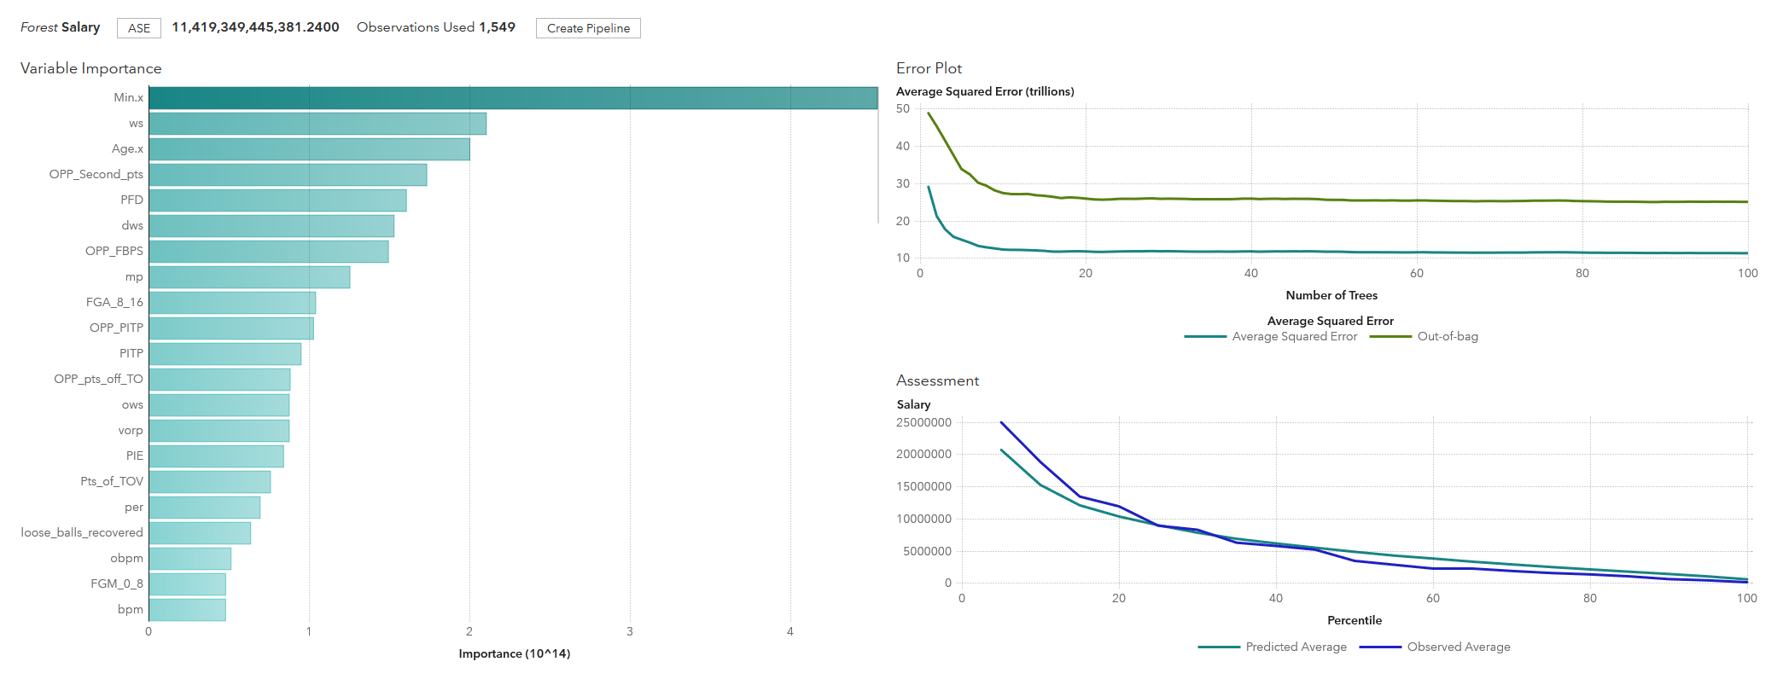
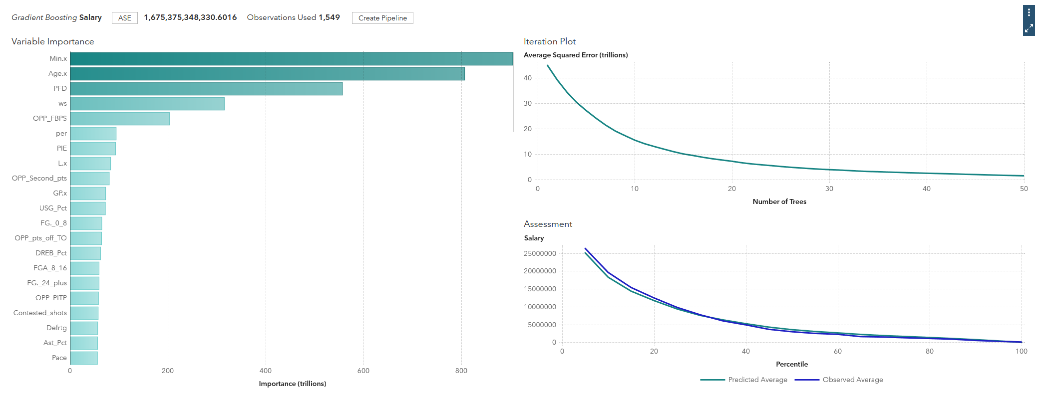
Best Models
Linear Regression
Random Forest
Gradient Boosting
Notes:
The first model is a simple linear regression. We only have an R-square of 55.68%, but I mainly wanted to use this regression as a good method of variable selection. A neural net performed better, but it is less explainable, and this is also a good buffer against overfitting in the ensemble.
The RMSE for the random forest was about $3 million dollars. We can see here that we have one very significant variable and a steady distribution of importance across the rest.
The RMSE for the gradient boosting model was about $1 million dollars. The distribution of important variables here is more exponentially skewed than the previous ones.

Slide 19
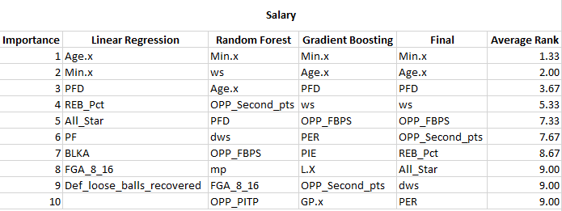
Averaged Ranks
Notes:
The previous models will be ensembled for predictions, but again we are using their feature selection to direct our analyses.

Slide 20
All Star Status
Notes:
As an added bonus to our prediction powers, we will be fitting models to predict a player’s all-star status. This one is fun because the primary selection criteria is fan votes, rather than pure statistical performance.

Slide 21
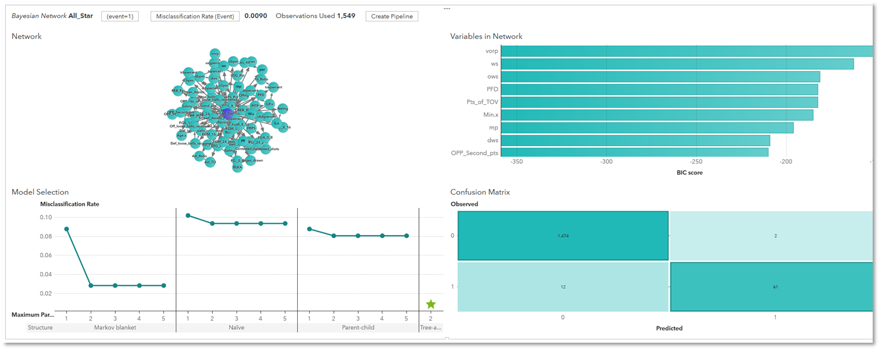
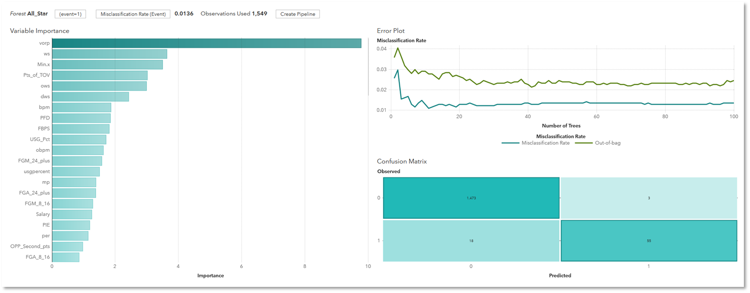
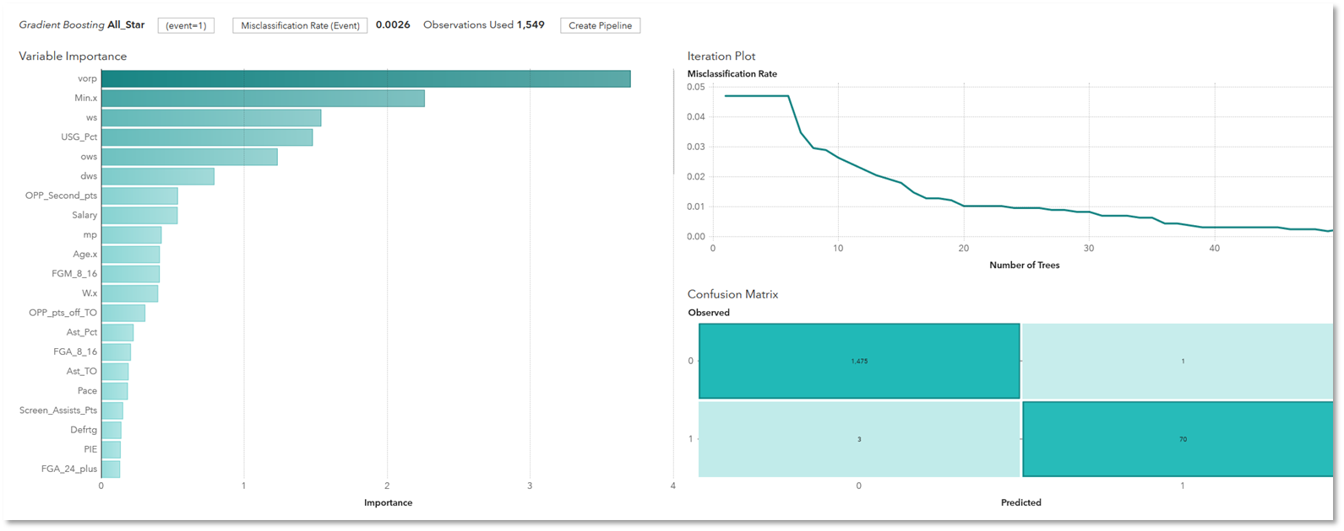
Best Models
Bayesian Network
Random Forest
Gradient Boosting
Notes:
Just like the other Bayesian Networks, we get a very small misclassification rate and a handful of important variables that are not too far apart from each other.
Random forest again is picking a feature it really likes. We can see that the number of trees does not help the model significantly once we get to 20 or so.
Finally, the gradient boosting model. All three of these models had the same #1 choice, just like the trio of models for predicting whether a team will make the playoffs.

Slide 22
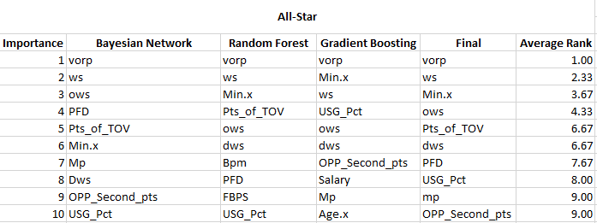
Averaged Ranks
Notes:
And we finally arrive at our top 10 variables for predicting whether a player will make the all-star team.

Slide 23
Model Performance
Notes:
Now, we will be getting into the details of how our model predictions went.

Slide 24
Case Study
2019 San Antonio Spurs and 2019 Memphis Grizzlies
Predictions for playoff team and beat expected wins
Predictions for player salaries and all-star status
How are they doing in statistical categories?
Notes:
To explore this, I am going to investigate the statistics of two teams during the 2019 season – Spurs and Grizzlies.
We will look at the predictions for playoff team and beat expected wins, the predictions for player salaries and all-star status, and finally inspect how each team compares to our previously generated clusters in the statistics we found to be important.

Slide 25
Team Stats Predictions
 | Prediction | Actual
Spurs – Playoff Team | TRUE | TRUE
Spurs – Beat Expected Wins | TRUE | TRUE
Grizzlies – Playoff Team | FALSE | FALSE
Grizzlies – Beat Expected Wins | FALSE | FALSE
Notes:
Starting off on a good note, the ensemble of models was able to correctly distinguish good and bad teams. In 2019, the Spurs both made the playoffs and beat expected wins – the Grizzlies did neither.

Slide 26
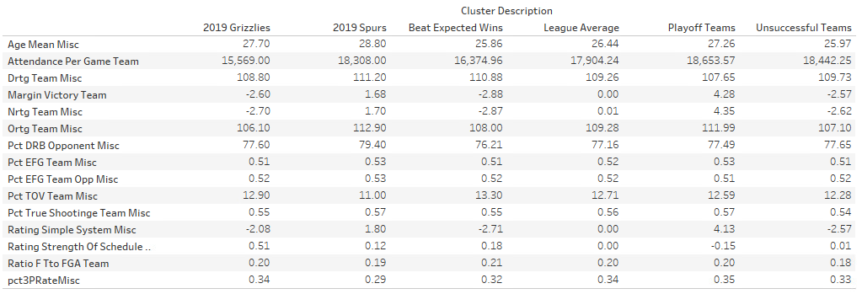
How do our teams compare?
Notes:
As I mentioned earlier, here we have a crosstab of the 3 clusters alongside our two specific teams and the overall league averages. We will dive into some visualizations to see some of the important variables better.

Slide 27
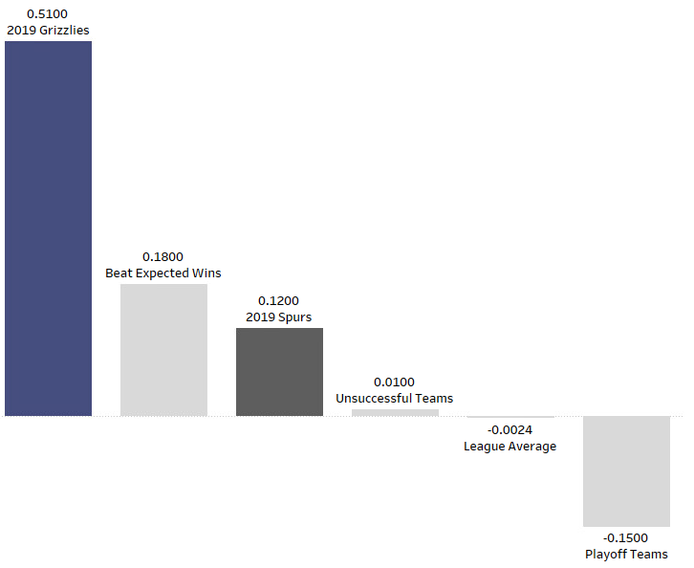
Strength of Schedule
Notes:
Strength of schedule was one of the moderately important variables for both playoff teams and beating expected wins. However, this is one of the most significant comparisons for our case study. We can see that the grizzlies had a much more difficult schedule than the other groups – possibly leading to why they didn’t make the playoffs or beat expected wins. Another important observation is that playoff teams had a negative difficulty in their schedule – meaning that they played more teams that were below-average than other teams.

Slide 28
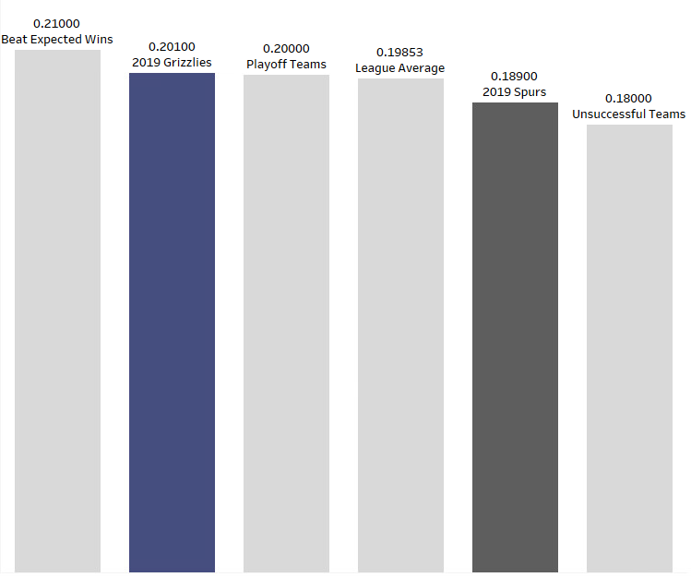
Ratio FT to FGA Team
Notes:
The ratio of free throws to field goals attempted was something I thought might be more significant coming into this, but it didn’t end up being as much so. Interestingly, we can see that teams that beat expected wins shoot free throws at the highest rate. This could be because they are able to slow down the game and keep games closer against teams that are better than them, giving them a higher chance of success.

Slide 29
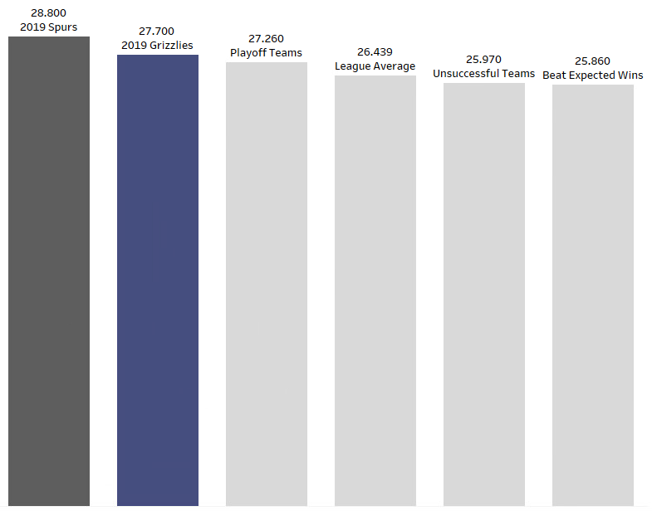
Average Age
Notes:
As I expected, playoff teams are older than the league average, and teams that beat expected wins are younger. Both of our case study teams are over the average for playoff teams. The lack of postseason success for the grizzlies while having an older roster probably indicates a rebuild to come.

Slide 30
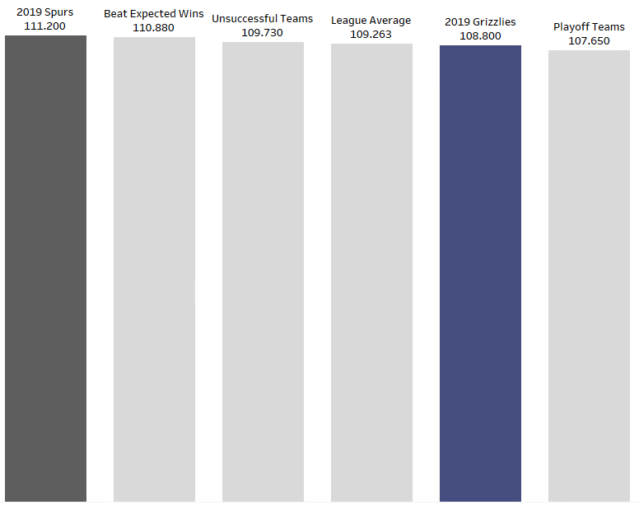
Defensive Rating
Notes:
Does defense win championships? Maybe. Slightly confusing, but a lower defensive rating is better. The playoff team average of 107 defensive rating essential equates to allowing 1.07 points to be scored by the opponent every possession. We can see that playoff teams do significantly better than others. The grizzlies had a great defensive rating but did not find success. Was a poor offensive rating the reason?

Slide 31
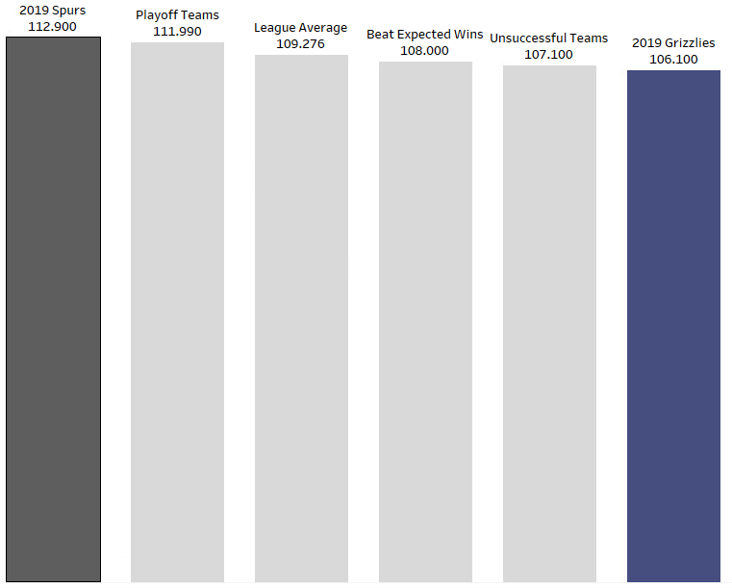
Offensive Rating
Notes:
As expected, the Grizzlies are much lower than the other groups in terms of offensive rating. While the Spurs had the worst defensive rating of the groups, they also have the best offensive rating. This juxtaposition is probably what landed them in both the playoff-team group as well as the beat expected wins group.

Slide 32
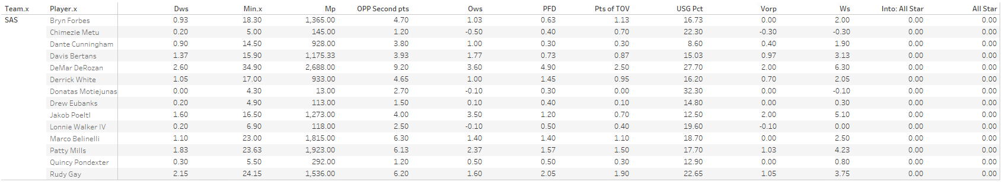
All-Star Predictions: Spurs
Predicted All-Stars | Actual All-Stars | Difference
0 | 0 | 0
Notes:
Looking at all-star predictions, our models correctly predicted that there were no all-stars on the Spurs in 2019. Not exciting, but accurate.

Slide 33
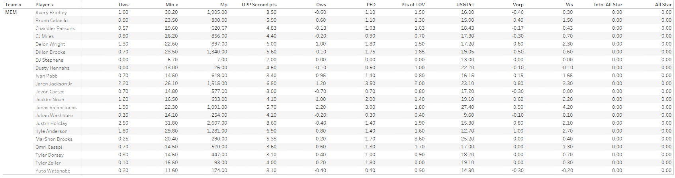
All-Star Predictions: Grizzlies
Predicted All-Stars | Actual All-Stars | Difference
0 | 0 | 0
Notes:
Similarly, our models went a perfect 0/0 for with all-star selections for the 2019 Grizzlies.

Slide 34
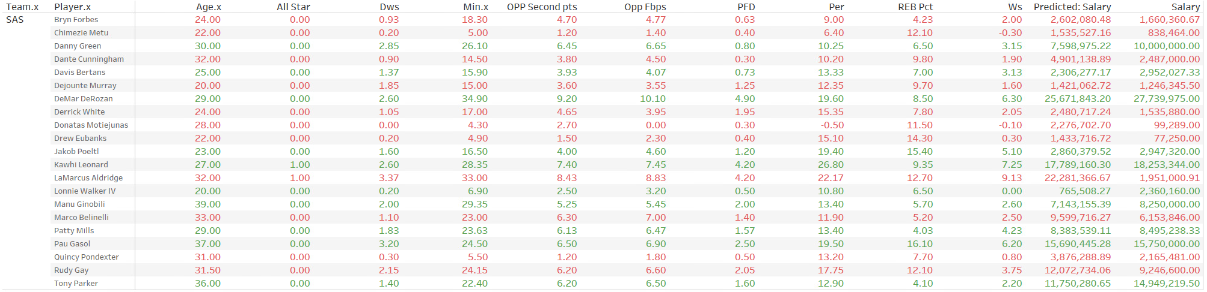
Salary Predictions: Spurs
Predicted Salary Total | Actual Salary Total | Difference
$99,959,564.11 | $111,697,284.17 | ($11,737,720.06)
Notes:
Slightly more exciting, we get into salary predictions. Players highlighted in red are being underpaid and players highlighted in green are being overpaid. For this year, the spurs paid out $11 million too much for the performance of their players.

Slide 35
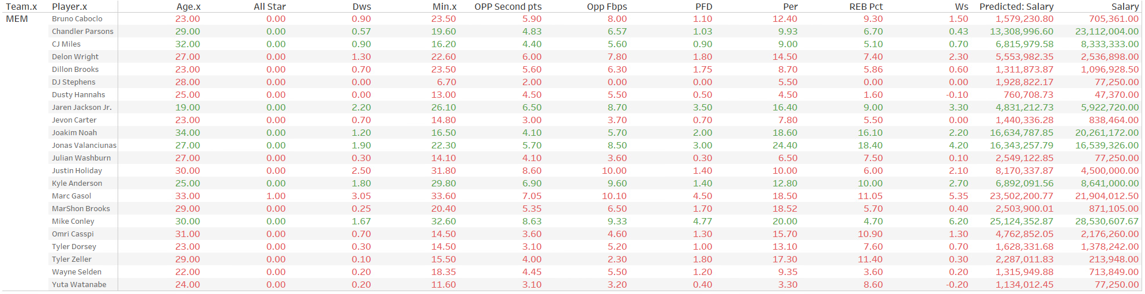
Salary Predictions: Grizzlies
Predicted Salary Total | Actual Salary Total | Difference
$89,950,678.98 | $111,340,162.67 | ($21,389,483.69)
Notes:
The Grizzlies were in a similar situation – but slightly more in the hole. They overpaid their players by $21 million. Mainly because of the underperformance of $10 million by Chandler Parsons.

Slide 36
Final Thoughts
Issues with the model that could be improved
Turn into a dynamic, interactive program
Notes:
This project was a great exercise for me in model improvements and data management. I constantly was changing features, directions of the project, and data structures throughout the semester.
I want to keep this project with me after the class, and hopefully develop an interactive web application to automate the pipeline and analysis that I created for this class.
As I work through some issues with the modeling that I discovered throughout the semester, such as getting negative predictions for salaries, I am excited at the possibility of creating a valuable product that could possibly be commercialized.

